Slide 1
CCDA 2021-2022 Board Leadership Volunteer Recruitment

Slide 2
Why Join our Leadership Board?
Collaborate with a dedicated, fun group of like-minded professionals
Create professional development opportunities for your local California career practitioner peers
Develop your skills: leadership, collaboration, event planning, publicity/marketing, member services, and much more!
Leadership and volunteer service in your field looks great on your resume
Many CCDA volunteers have obtained meaningful employment through CCDA contacts
CCDA member are mentors
CCDA professionals are great resources for industry knowledge & sharing best practices
CCDA members refer clients to other CCDA members

Slide 3
Video (From 2020-21 Recruitment Cycle)

Slide 4
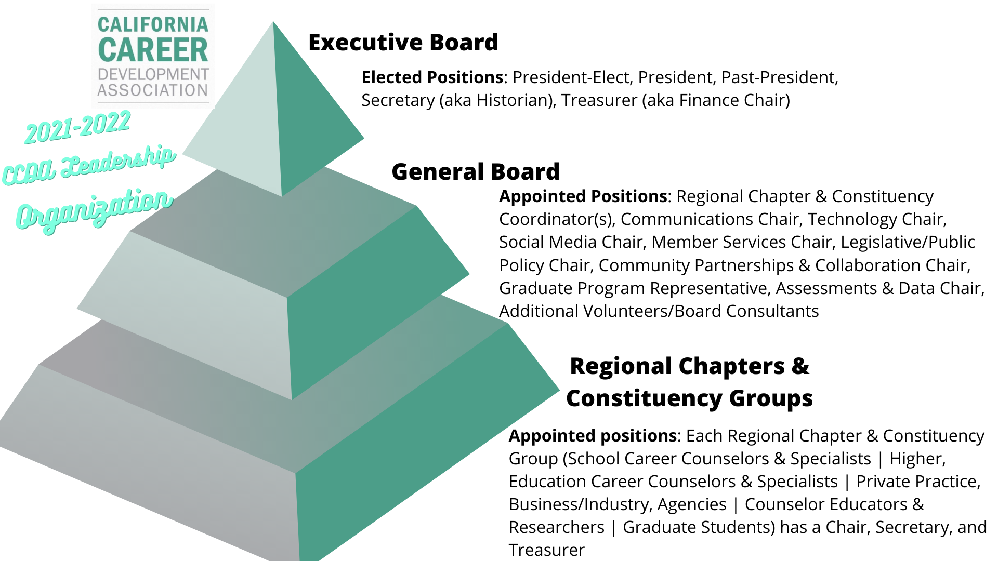
2021-22 CCDA Organizational Structure

Slide 5
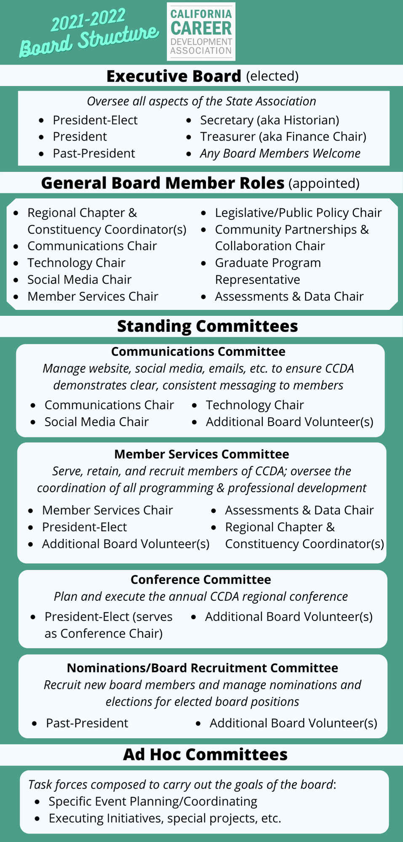
2021-22 Board Structure
Executive Board
General Board
Condensed description of each board role
Standing Committees (All board members welcome to join any committee of interest)
Ad Hoc Committees (shape other committees as projects/goals come up)
All Committees Meet Monthly
Quarterly Full Board Calls
2 Board Retreats - July & January

Slide 6
2021 Recruitment Timeline
April 16th, 10am - board leadership volunteer recruitment info session
April 16th-May 14th - Call for nominations for elected positions and committees (self-nominations encouraged)
May 15-May 28 - nominations committee vet candidates and choose an executive board slate
May 31- June 14 - voting period for executive committee
June 15-30 - finalize elections and committee assignments, announce executive board

Slide 7
What are we looking for?
Qualities we value in board members include:
Communication
Collaboration
Follow-through
Leadership / Vision
Diverse experiences & perspectives
Career practitioners in various regions of California
Career practitioners in various sectors (private practice, k-12, higher ed, etc.)
Career practitioners with various backgrounds & identities (ethnicity, gender, etc.)
Commitment to the Organization
Current CCDA member
Previous Board Leadership Experience

Slide 8
CCDA 2021-2022 Priorities
Intra-Board:
Sustainability/Consistency
Clarity/Transparency
Ownership
Organization
Data - gathering, analyzing, and implementing
Association-wide:
Equity - within & beyond association
Support & healing - collective trauma of pandemic
Upholding our mission:
Professional Development
Community Building / Networking
Advocacy on Behalf of the Profession

